Slide 1
Preventing and fighting against diseases
for good health
Module-5

Slide 2
1) Management of chronic illness for better quality of life
2) Health and Wellness of Youth- a challenge for upcoming future
3) Measuring of health and wellness

Slide 3
Disease:disease is something that needs to be cured, such as infection, injury,
toxic exposure, cell degeneration, etc
Illness: is something that needs to be managed such as feelings of pain, discomfort, distress, weakness,etc

Slide 4
Germs according to CDC (CENTER FOR DISEASE CONTROL AND PREVENTION)
Germs are a part of everyday life and are found in our air, soil, water, and in and on our bodies.
Some germs are helpful, others are harmful. Many germs live in and on our bodies without causing harm and some even help us to stay healthy.
An infection occurs when germs enter the body, increase in number, and cause a reaction of the body.
• Three things are necessary for an infection to occur:
1.Source: Places where infectious agents. (germs) live (e.g., sinks, surfaces, human skin)
2. Susceptible Person with a way for germs to enter the body.
3. Transmission: a way germs are moved to the susceptible person

Slide 5
Sources of Infections
A Source is an infectious agent or germ and refers to a virus, bacteria, or other microbe.
In healthcare settings, germs are found in many places. People are one source of germs including:
Patients
Healthcare workers
Visitors and household members

Slide 6
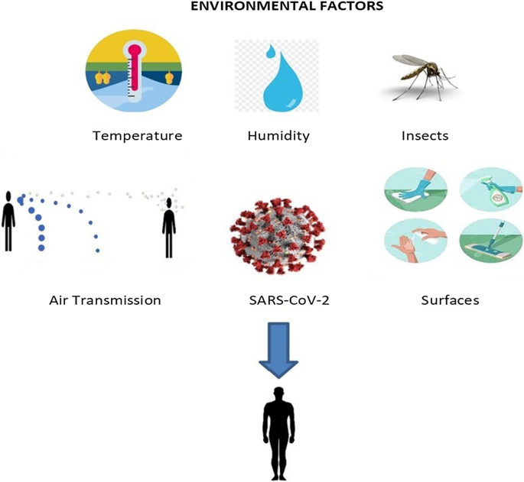
Examples of environmental source of germs

Slide 7
Reasons for Infection from Sources
1. Dry surfaces in patient care areas (e.g., bed rails, medical equipment, countertops, and tables)
2. Wet surfaces, moist environments, and biofilms (e.g., cooling towers, faucets and sinks, and equipment such as ventilators)
3. Indwelling medical devices (e.g., catheters and IV lines)
4. Dust or decaying debris (e.g., construction dust or wet materials from water leaks)

Slide 8
Susceptible People for infections
1.A susceptible person is someone who is not vaccinated or otherwise immune, or a person with a weakened.
2. Patients in healthcare who have underlying medical conditions such as diabetes, cancer, and organ transplantation are at increased risk for infection because decrease the immune system ability to fight infection.
3. Certain medications used to treat medical conditions, such as antibiotics, steroids, and certain cancer
fighting medications increase the risk of some types of infections

Slide 9
Transmission of infection
Transmission refers to the way germs are moved to the susceptible person. Germs don’t move themselves.
Germs depend on people, the environment, and/or medical equipment to move in healthcare settings.
• Contact moves germs by touch. Touching the eye, nose, mouth or wounds after contact.
• Sprays and splashes occur when an infected person coughs or sneezes, creating droplets which carry germs short distances (within approximately 6 feet).
• Sharps injuries can lead to infections (example: HIV, HBV, HCV) when bloodborne pathogens enter a person through a skin puncture by a used needle or sharp instrument

Slide 10
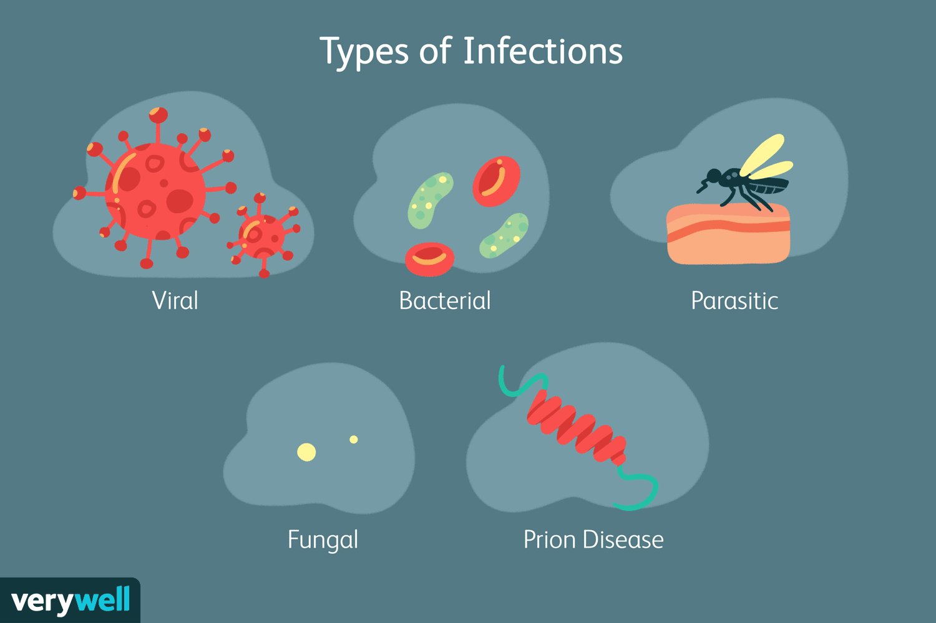

Slide 11
Infectious agents come in many shapes and sizes. Categories include
Bacteria : Bacteria are one-celled organisms that can be seen only with a microscope.Strep throat.
Viruses: Viruses are much smaller than cells. AIDS Common cold, Ebola, Genital herpes, Influenza.
Fungi There are many varieties of fungi, and people eat several of them.
Protozoans: Protozoans are single-celled organisms that behave like tiny animals hunting and gathering

Slide 12
How to protect from transmitted infections
Avoid close contact with people who are sick.
Cover coughs and sneezes
Avoid touching your face.
Stay home if you’re sick.
Clean and disinfect surfaces that are touched often
Avoid contaminated food and water.
Hand-washing, Medicines and Vaccines.
Avoid contaminated food and water.
Stay home if you’re sick.

Slide 13
How to reduce risks for good health
1. Be a non-smoker and avoid second hand smoke. If one smokes need to get help to quit
2.Be physically active everyday.
3.Eat healthy foods
4.Achieve a healthy weight
5.Control your blood pressure.
6.Reduce your stress.
7.Be screened or tested regularly.
8.Practice Hygiene.

Slide 14
Reducing risks and coping with chronic conditions
Chronic illness
Chronic diseases are defined broadly as conditions that last for one year or more and require ongoing medical attention, as well as limit activities of daily living.
Example: heart disease, cancer, diabetes
Based on the latest data from C D C (centre for disease control), 10 most expensive chronic diseases are:
• Cardio vascular diseases
• Smoking related health issues
• Alcohol related health issues
• Diabetes
Cancer
• Obesity
• Arthritis
• Asthma
• Stoke

Slide 15
Additional demands of chronic illness
– Understand the condition
– Know about the treatment and therapy
– Maintain trust and confidence in the doctors,
– Especially when recovery isn’t possible
– Know how to control the symptoms
-Avoid social isolation

Slide 16
Components of quality of life
Quality of life has several components. Specifically,
1.Physical functioning
2.Psychological status
3.Social functioning
4.Disease or treatment

Slide 17
Assessment of quality of life in chronic illness
The assessment of the quality of life of chronically will was based on how
much the disease and treatment interferes with the activities of daily living such as
Sleeping
Eating,
Going to work and
Engaging in recreational activities

Slide 18
How to maintain better quality of life in the chronically ill?
. •Get a prescription for information.
• Make your doctor a partner in care.
•Build a team.
• Coordinate your care.
• Make a healthy investment in yourself.
• Make it a family affair.
• Manage your medications.
• Beware of depression.
• Reach out. (Doctors, nurses)
•Plan for end-of-life decisions.

Slide 19
Pain management:
1.Taking pain relieving medicine. Medication includes both non-prescription
medication and prescription medication.
2.Under going physical therapies
Physical therapies also are found in stretching exercises, walking and other
exercises
3.Relaxation and stress management techniques
• Transcutaneous electrical stimulation therapies
• Applying heat packs and cold packs

Slide 20
Good life style choices for better quality of life
1.Maintain a healthy life style can help the chronically ill patient to feel well, while living with chronic illness and its condition.
This includes eating well, doing as much physical activity as the patient’s condition will allow, and getting good rest
2. Trying to do some physical activity each day, even if itis only a small amount, can help with managing pain and lift your mood.
3.Sleep is also very important if there is a health
condition

Slide 21
Getting support from others for better quality of life
1.Social support can help chronically ill person to maintain a good quality of life.
2.When a chronically ill person has a long term adverse health condition the person must plan to catch up with family and friends and inform about their condition.

